Slide 1
SECURE DATA HIDING IN IMAGES USING Steganography
CAPSTONE PROJECT
Presented By: Rajat Verma
Student Name : Rajat Verma
College Name & Department : Thakur College of Engineering & Technology (E&TC)

Slide 2
OUTLINE
Problem Statement
Technology used
Wow factor
End users
Result
Conclusion
Git-hub Link
Future scope

Slide 3
Problem Statement
Steganography is used to hide secret data within images for secure and covert communication.
The challenge is to embed data while maintaining the visual integrity of the image.
Hidden information must remain undetectable and retrievable only by authorized parties.
Effective steganography requires balancing data capacity, imperceptibility, and robustness against detection and tampering.

Slide 4
Technology used
Steganography hides data within images without altering their appearance.
It uses techniques like Least Significant Bit (LSB) and encryption for security.
It's applied in secure communication, watermarking, and digital forensics.
Challenges include balancing data capacity and image quality, while advanced methods like AI improve security. It can be misused, raising legal concerns.
Use Python IDE to run code
import cv2
import os
import string

Slide 5
Wow factors
Invisible data embedding: Hides data without affecting image appearance.
Encryption integration: Adds extra security by encrypting data before embedding.
Advanced algorithms: Uses DCT, DWT, and other sophisticated techniques.
Capacity and quality balance: Optimizes data storage without compromising image quality.
AI-based detection avoidance: Uses machine learning to prevent detection.
Multi-layer embedding: Hides data in multiple layers or color channels for more capacity.
Steganalysis resistance: Designed to evade detection tools.
Real-time secure communication: Supports fast, secure data transmission.

Slide 6
End users
Government Agencies: For secure, confidential communication.
Military and Defense: To covertly transmit classified information.
Corporate Entities: To protect proprietary data and internal communications.
Digital Forensics Experts: To detect and recover hidden data.
Journalists and Activists: For secure transmission of sensitive information.
Cryptographers: To develop secure encryption methods.
Copyright Holders: For embedding digital watermarks and proofs of ownership.
Data Privacy Advocates: To ensure secure transmission of personal data.

Slide 7

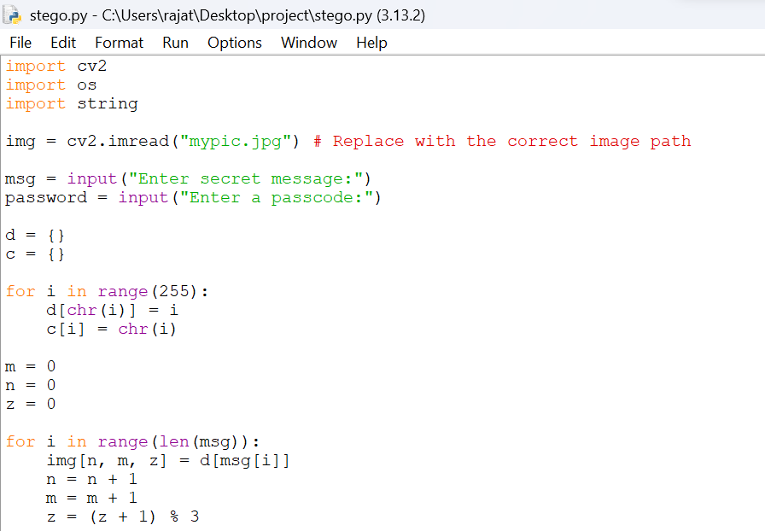
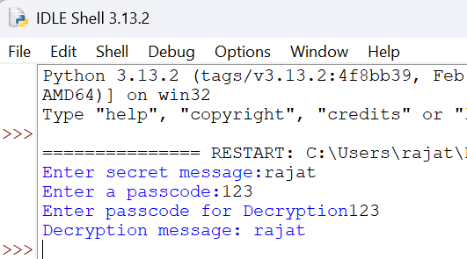
Results

Slide 8
Conclusion
Steganography is a powerful tool for secure data hiding, but it should be used responsibly and ethically. Always ensure that you have proper authorization to embed or extract data from images.
In this project, we successfully implemented secure data hiding in images using steganography to ensure confidentiality and protect sensitive information from unauthorized access. By embedding secret data within digital images, we achieved a balance between security, imperceptibility, and robustness. The method used ensures that the hidden data remains undetectable to the human eye while maintaining the integrity of the cover image.

Slide 9
GitHub Link
https://github.com/rajat453/My-aicte-project.git

Slide 10
THANK YOU

